Slide 1

Multi-Campus University Management System
By Ishita Nakhawa Roll No.: 150096725213

Slide 2
INDEX
Problem Statement
Solution
Working (Method/Mind map)
Conclusion.

Slide 3
Problem Statement
The Challenge: Managing multiple university campuses centrally is complex when each location maintains separate or manual records.
Manual Data Entry: Time-consuming processes with a high risk of error and duplication across campuses.
Fragmented Records: Difficulty tracking student data across different regions without a unified view.
No Unified Reporting: Lack of centralized reporting for total fees, student counts, and campus analytics.
Goal: Create a centralized, digital ERP-style system to streamline multi-campus operations.

Slide 4
Solution
The Concept: A menu-driven console application developed in C++ that acts as a central hub for all campus data.
Core Features (CRUD):
Create: Add new student profiles with unique IDs.
Read: View all records or filter by specific campus/name.
Update/Delete: Modify or remove records dynamically.
Persistence: Uses File Handling (fstream) to save data to students.txt, ensuring information isn't lost when the program closes.

Slide 5
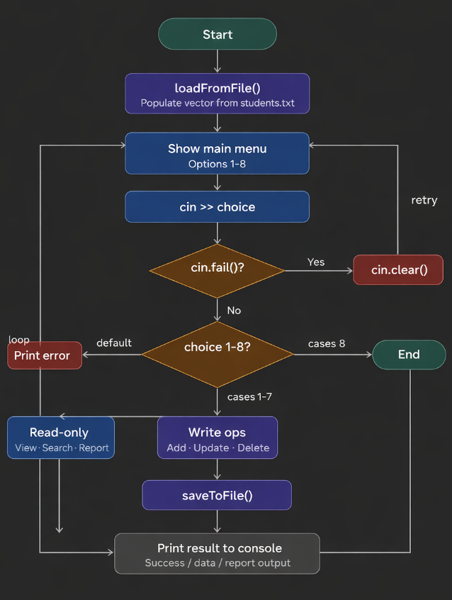
Working
The Multi-Campus University Management System follows a structured and efficient process flow. On startup, the program automatically loads all existing student records from students.txt into memory using loadFromFile(). The user is then presented with a main menu where they can choose from operations such as Add, View, Search, Update, Delete, or Generate a Report. Every input is validated to prevent crashes from invalid entries. Searching is performed using a linear scan through the student vector via the .find() method. After every change — whether adding, updating, or deleting a record — the system immediately writes the updated data back to disk using saveToFile(), ensuring no data is ever lost.

Slide 6
Conclusion
Project Success: Successfully demonstrated a centralized approach to multi-campus management.
Technical Takeaways:
Efficiently utilized C++ STL (vectors, maps).
Implemented robust file handling for permanent storage.
Impact: Reduces manual effort and provides instant access to university-wide data through an ERP-like interface

Slide 7
Thank you.

